Slide 1
Planning Optimization Refresher
Dynamics 365 FastTrack Architecture Insights Series

Slide 2
Agenda
What is Planning Optimization
Architecture
FAQ
Recently released features
Deprecation and removal
Implementation process
Resources

Slide 3
What is Planning Optimization?
Microservice that runs MRP on a separate workload
Reduces Master planning run time down to minutes
Leverages same configurations as classic MRP
Notes:
First, let’s review what Planning Optimization is
CLICK: Planning Optimization is an add-in service for Dynamics 365 SCM that will replace classic MRP. It is included in the licensing for SCM and does not incur additional costs for users. As a note, because this is an LCS add-in, it is only available in Tier 2+ environments.
CLICK: By running planning on a separate workload, Planning Optimization allows companies to run master planning much more quickly and therefore more frequently, addressing our long-standing performance constraints with classic MRP
CLICK: Since Planning Optimization was introduced, the product team has been working of providing full feature parity with classic MRP in the new service. Currently we support most distribution scenarios and as detailed in the release notes for Wave 1 2022, the majority of the remaining scenarios are slated to be completed by October 2022
CLICK: It’s also important to note that net-new features that have been added to the master planning module, such as priority based planning, are only compatible with Planning Optimization and not with classic MRP

Slide 4
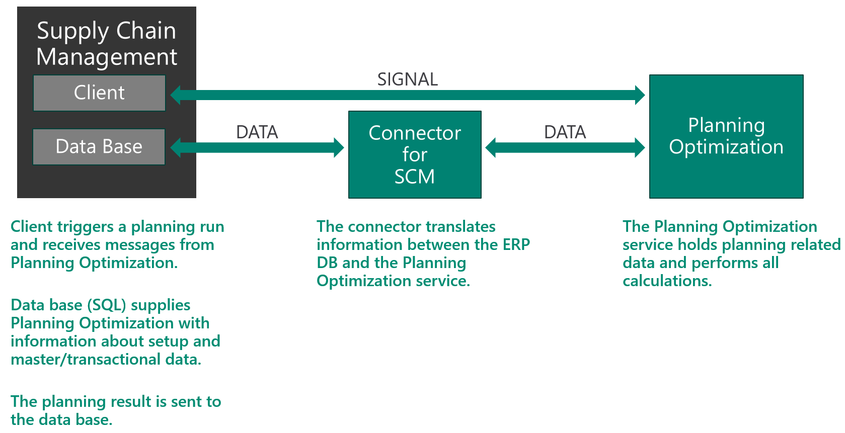
Planning Optimization architecture

Slide 5
Planning Optimization FAQ
No additional cost
Only available on cloud-hosted environments (Tier 2+)
Does not have full 1:1 feature mapping with classic Master Planning

Slide 6
Recent Planning Optimization features
Recently released
Finite capacity scheduling
CTP
Private preview
Support for supply forecast
Wave 2 2022
Planning items
Freeze time fence
Forecast time fence support
Support for sales quotations
BOM lines with resource consumption
Plan parameters; Include On-hand, Include Inventory transactions
Batch disposition codes
Group transactions
Plan groups
Formula measurement
BOM lines with negative qty
BOM lines with step consumption
BOM lines with scrap
Specific BOM or Route assignment
Co-products
Yield
Sequencing
RFQs
Shelf life
Subcontracting
Transfer order lead times
Action messages
Base calendars

Slide 7
When will classic MRP be removed?
Deprecation
Removal
Reduced/no support on bugs
Warning message when running classic MRP
Not compatible with new features (DDMRP, multi-sourcing)
Distribution – April 2021
Manufacturing – April 2022
Functionality removed from system
Not announced, no current timeline
12 - 18 month transition window (likely) after announcement
Notes:
Probably the most frequently asked question we hear from customers is around the removal of classic MRP from Dynamics. Let’s review now the different stages in the removal process and the timelines that have currently been announced
CLICK: the first step in features being removed from the product is deprecation.
CLICK: Distribution scenarios in classic MRP have been deprecated as of April 2021 and Manufacturing scenarios were deprecated in April 2022. Each of these dates were announced a year or so in advanced of the deprecation
CLICK: Now, what that means is not that the functionality is removed, but that support of bugs in the functionality is greatly reduced (although exceptions are made for bugs in features that do not have parity in Planning Optimization). If you run classic MRP in your environment, you will receive a warning message that tells you it is deprecated and you need to move to planning optimization. However, classic planning will still generate planned orders. If you are not able to adopt Planning Optimization yet, you can request an exception from the product group which would prevent the warning message when running classic MRP. And finally, a reminder that while classic MRP still works even though it is deprecated, it is not compatible with any of the new features that have been released or are on the roadmap, like priority based planning and DDMRP.
CLICK: The next step after deprecation would be removal of the functionality from the system
CLICK: Before we start worrying, I want to make sure we note that removal has NOT been announced for classic MRP and that there are no plans to remove it until all of our customers are able to adopt the new service. Once that goal is achieved, even when removal is announced, it will not be effective for 12-18 months or so from the announcement date, which will allow our customers plenty of time to plan their transition to planning optimization. Again, I want to stress that this is not something that has been announced or has any date assigned currently, but we should be aware that it is down the road. For more information regarding the process for requesting extensions, you can refer to the link at the bottom of the slide.

Slide 8
Implementing Planning Optimization
Run Planning Optimization Fit Analysis
Review differences between built-in master planning and Planning Optimization
Install add-in on a non-production environment
Test - compare classic MRP with Planning Optimization results
Install and enable in production environment

Slide 9
Resources
Yammer : Dynamics 365 and Power Platform Insider Program : Planning Service
Dynamics 365 Supply Chain Management Forum - Support & Help
Planning Optimization overview - Supply Chain Management | Dynamics 365 | Microsoft Learn
Migration to Planning Optimization for master planning - Supply Chain Management | Dynamics 365 | Microsoft Learn

Slide 10

Questions?

